Slide 1
Topics (Chapter 8)
One-Dimensional Arrays
Array declaration
Array initialization
Array subscripting
Variable-length arrays
Problem solving with arrays
Multidimensional Arrays

Slide 2
Arrays

Slide 3
One-Dimensional Arrays
To declare an array, we must specify the type of the array’s elements and the number of elements:
int a[10];
The elements may be of any type; the length of the array can be any (integer) constant expression.

Slide 4
One-Dimensional Arrays
Using a macro to define the length of an array is an excellent practice:
#define N 10
…
int a[N];

Slide 5
Array Initialization
An array, like any other variable, can be given an initial value at the time it’s declared.
The values are undefined if an array has not been initialized.
The most common form of array initializer is a list of constant expressions enclosed in braces and separated by commas:
int a[10] = {1, 2, 3, 4, 5, 6, 7, 8, 9, 10};
5

Slide 6
Array Initialization
Initialize an array to all zeros:
int a[10] = {0};
/* initial value of a is {0, 0, 0, 0, 0, 0, 0, 0, 0, 0} */
There’s a single 0 inside the braces because it’s illegal for an initializer to be completely empty.
6

Slide 7
Array Initialization
If an initializer is present, the length of the array may be omitted:
int a[] = {1, 2, 3, 4, 5, 6, 7, 8, 9, 10};
The compiler uses the length of the initializer to determine how long the array is.
7

Slide 8
Constant Arrays
An array can be made “constant” by starting its declaration with the word const:
const char chars[] =
{'0', '1', '2', '3', '4', '5', '6', '7', '8', '9',
'A', 'B', 'C', 'D', 'E', 'F'};
An array that’s been declared const should not be modified by the program.
Documents that the program won’t change the array.
Helps the compiler catch errors.

Slide 9
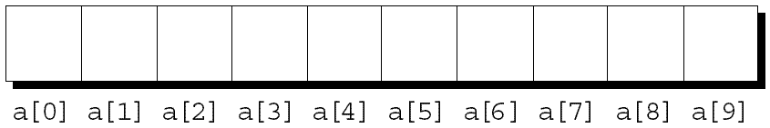
Array Subscripting
To access an array element, write the array name followed by an integer value in square brackets.
The elements of an array of length n are indexed from 0 to n – 1.
If a is an array of length 10, its elements are designated by a[0], a[1], …, a[9]:

Slide 10
Array Subscripting
Examples of typical operations on an array a of length N:
for (i = 0; i < N; i++)
scanf("%d", &a[i]); /* reads data into a */
for (i = 0; i < N; i++)
sum += a[i]; /* sums the elements of a */

Slide 11
Array Subscripting
C doesn’t require that subscript bounds be checked; if a subscript goes out of range, the program’s behavior is undefined.
A common mistake: forgetting that an array with n elements is indexed from 0 to n – 1, not 1 to n:
int a[10], i;
for (i = 1; i <= 10; i++)
a[i] = 0;

Slide 12
Variable-Length Arrays
Use an expression instead of a constant for the length of array.
int n;
printf(“Enter the length of the array:”);
scanf(“%d”, &n);
int a[n];
/* array is declared after n is read*/
12

Slide 13
Exercise
The following code accomplishes which of the tasks written below? Assume list is an int array with 5 elements that stores positive int values only.
int foo = 0, j;
for (j =0 ; j < 5; j++)
if (list[j]) >foo) foo = list[j];
It stores the largest value in list (the maximum) in foo
It stores every value in list, one at a time, in foo, until the loop terminates
It stores the smallest value in list (the minimum) in foo
It counts the number of elements in list that are greater than foo

Slide 14
Example Program
Find largest element of an integer array entered by the user

Slide 15
Example Program
Reverse the elements in an array
Key concept: swap two variables x and y
int tmp = x;
x = y;
y = tmp;

Slide 16
Multidimensional Arrays

Slide 17
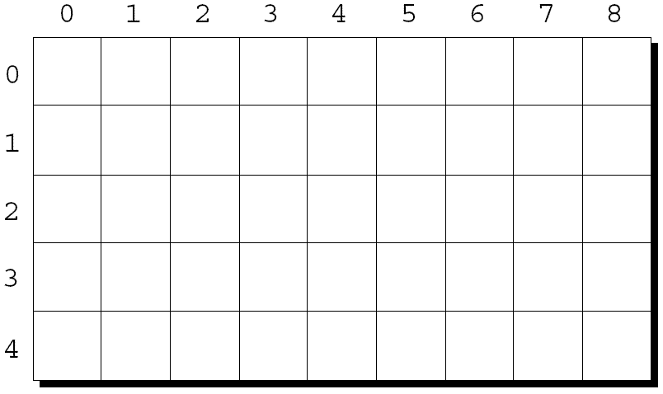
Multidimensional Arrays
The following declaration creates a two-dimensional array (a matrix, in mathematical terminology):
int m[5][9];
m has 5 rows and 9 columns. Both rows and columns are indexed from 0:

Slide 18
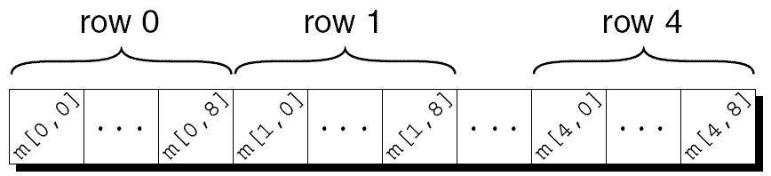
Multidimensional Arrays
To access the element of m in row i, column j, we must write m[i][j].
The expression m[i] designates row i of m, and m[i][j] then selects element j in this row.
C stores arrays in row-major order, with row 0 first, then row 1, and so forth.
How the m array is stored:

Slide 19
Multidimensional Arrays
Consider the problem of initializing an array for use as an identity matrix. A pair of nested for loops is perfect:
#define N 10
double ident[N][N];
int row, col;
for (row = 0; row < N; row++)
for (col = 0; col < N; col++)
if (row == col)
ident[row][col] = 1.0;
else
ident[row][col] = 0.0;

Slide 20
Initializing a Multidimensional Array
We can create an initializer for a two-dimensional array by nesting one-dimensional initializers:
int m[5][9] = {{1, 1, 1, 1, 1, 0, 1, 1, 1},
{0, 1, 0, 1, 0, 1, 0, 1, 0},
{0, 1, 0, 1, 1, 0, 0, 1, 0},
{1, 1, 0, 1, 0, 0, 0, 1, 0},
{1, 1, 0, 1, 0, 0, 1, 1, 1}};

Slide 21
Example Program
Write a program that calculates the row sums for each row and the column sums for each column for the following two-dimensional array:
int m[2][3] = {{9, 7, 4},
{20, 15, 3}};
row_sum: 20, 38
col_sum: 29, 22, 7

Slide 22
Exercise: Anagrams, Part 1
Write a program that tests whether two words are anagrams.
Reads a word, character by character, using an array of 26 integers to keep track of how many times each letter has been seen. Assume the letter are lower case.
Display the values of the array.

Slide 23
Exercise: Anagrams, Part 1 cont’d
For example, after the word smartest has been read, the array should contain the values 10001000000010000122000000, reflecting the fact that smartest contains one a, one e, one m, one r, two s’s and two t’s.

Slide 24
Exercise: Anagrams, Part 2
Modify the program so that tests whether two words are anagrams (permutations of the same letters):
Enter first word: smartest
Enter second word: mattress
The words are anagrams.
Enter first word: dumbest
Enter second word: stumble
The words are not anagrams.

Slide 25
Exercise: Anagrams, Part 2 cont’d
Use another loop to read the second word, except this time decrementing the corresponding array element as each letter is read.
After the second word has been read, use another loop to check whether all the elements in the array are zero. If so, the words are anagrams.

